Slide 1

Indian Institute of Information Technology Pune
Department of Computer Science Engineering 2022-2023
Project on
“Smart Farming Crop Yield Prediction using Machine Learning”
V. Bharadwaj - (112015160)
G.Manoj Reddy - (112015054)
R.Suraj Rao - (112015108)
U.Vinod Kumar - (112015158)
Project Supervisor - Prof. Ritu Tiwari

Slide 2
Outline
Introduction
Motivation
Objective
Literature Survey
Methodology
Results and Discussion
Conclusion and future scope
References

Slide 3
Introduction
Agriculture is the backbone of Indian economy. Farming is a highly difficult and demanding occupation. Due to a variety of causes, farmers in our nation endure great challenges. Lack of knowledge or inaccurate information is the major cause of their suffering. By ensuring that our cultivators receive more sophisticated information about the best crop that can be harvested to ensure maximum yield by taking into account factors like humidity, rainfall, soil nutrition, and precipitation levels in their locality, the agriculture sector in our nation could be significantly strengthened. We can provide farmers the most accurate forecasts and recommendations via the use of contemporary machine learning algorithms, enabling them to generate high-quality yields and enjoy the profits.

Slide 4
Motivation
Farmers may only benefit from the ultimate yield if they harvest the crop that is appropriate for the field's circumstances. This may be achieved by carefully examining the soil and climate data.
We require a lot of soil content and nature estimations and predictions. Machine learning and deep learning algorithms may be used to easily make these predictions based on vast datasets.

Slide 5
Objective
The main objectives of this project are:
To increase the accuracy of crop yield prediction by using different machine learning and deep learning algorithms.
To help farmers to choose a suitable crop to cultivate in order to maximize the yield by predicting the disease with image detection.
Also Recommends Farmers to use right Pesticides for the diseases.
To give farmers a generic idea on how external factors (like temperature,rainfall etc.)can influence their yield.

Slide 6
Literature Survey
Author | Title | Learnings
Anakha Venugopal, Aparna S, Jinsu Mani, Rima Mathew, Vinu Williams | Crop Yield Prediction using Machine Learning Algorithms,2021 | This Paper is mainly focused on using machine learning algorithms like Logistic regression, Naive bayes, Random forest.
Dhivya Elavarasan, P. M. Durairaj Vincent | “Crop Yield Prediction Using Deep Reinforcement Learning Model for Sustainable Agrarian Applications”, IEEE Access, 2020 | Focuses on crop yield prediction using deep reinforcement learning techniques like ANN and RNN
Thomas van Klompenburg, Ayalew Kassahun,Cagatay Catal | “Crop yield prediction using machine learning: A systematic literature review” Computers and Electronics in Agriculture, Volume 177, October 2020 | This paper is mainly focused on ML algorithms like linear regression,random forest,gradient boosting tree and DL algorithms like CNN , DNN and LSTM.

Slide 7
Author | Title | Learnings
Sangeeta, Shruthi G | “Design And Implementation Of Crop Yield Prediction Model In Agriculture”,2020 | This Paper includes Machine learning algorithms like random forest,polynomial regression,decision trees for forecasting crop yield based on climatic parameters
YongKang Xing, JiaPeng Huang, YongYao Lai | “Research and Analysis of the Front-end Frameworks and Libraries in E-Business Development”, Proceedings of the 2019 11th International Conference on Computer and Automation Engineering - ICCAE 2019, 2019. | This paper describes three different front-end development frameworks and libraries for developing web applications and also lists potential solutions for developing a web application. Uses React, Angular 2, Vue
Ranjini B Guruprasad, Kumar Saurav, Sukanya Randhawa | “Machine Learning Methodologies for Paddy Yield Estimation in India: A CASE STUDY”, 2019

Slide 8
Methodology
Step1: Import datasets- Collect datasets and merge these datasets in a structured form.
Step 2:Data Preprocessing -It is done to remove inaccurate, incomplete and unreasonable data which results in increase in quality of the data and hence the overall productivity using standard preprocessing techniques.
Step 3:Train-Test Splitting- Divide the analysed crop data into training and testing sets and train the model using the training data to predict the crop yield for given inputs.
Step 4:Feature Extraction- It is the process of reducing the raw data into manageable groups (features) for processing it. Beginning with an initial set of raw data it builds up derived values (features) which results in an informative and non-redundant data.
Step 5:Algorithms- Compare results of various algorithms by passing the analysed dataset through them and calculating the error rate and accuracy for each. Choose the machine learning algorithm with the highest accuracy and lowest error rate.
Step 6:Testing- Test the implemented system on the testing set to check for accuracy and failures.

Slide 9
Visual Representation of Methodology
Collecting Raw Data
Data Preprocessing
Split Into Training and Testing Dataset
Fitting of the Model
Accuracy of the Model
Confusion Matrix and Classification Report
Prediction
Score over Training Model

Slide 10
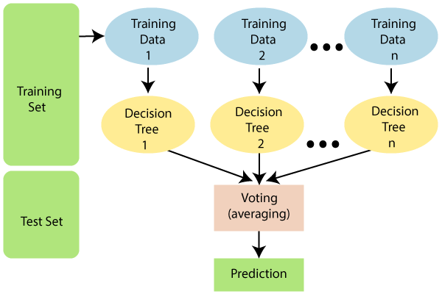
Random Forest Regression
Random forest regression is an ensemble machine learning technique.
A random forest is a meta estimator that fits a
number of classifying decision trees on various
sub-samples of the dataset and uses averaging
to improve the predictive accuracy and control
over-fitting.

Slide 11
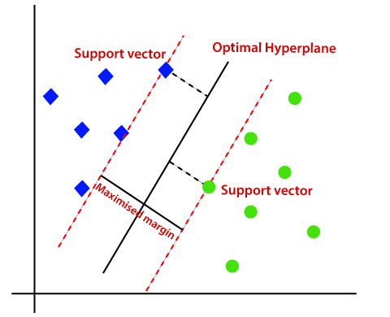
Support Vector Regression
Support Vector Regression(SVR) uses the Support Vector Machine(SVM) algorithm to predict a continuous variable.Support Vector Regression tries to fit the best line within a predefined or threshold error value.
Support Vector Machines are supervised learning models with
associated learning algorithms that analyze data used for classification
and regression analysis.
In Support Vector Regression, the straight line that is required to
fit the data is referred to as hyperplane.
This algorithm acknowledges the presence of non-linearity in the data
and provides a proficient prediction model.

Slide 12
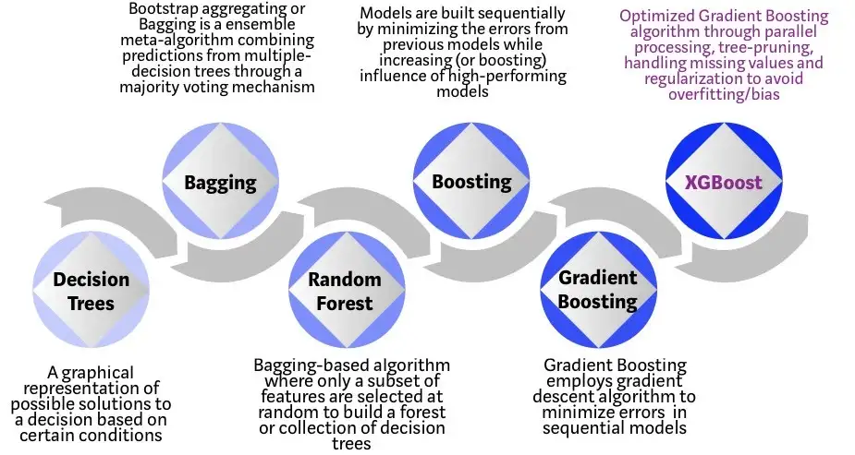
XGBoost

Slide 13
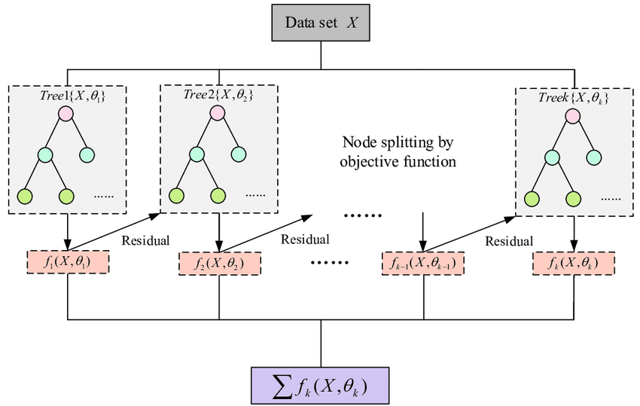
XGBoost is an implementation of Gradient Boosted decision trees. In this algorithm, decision trees are created in sequential form.
Weights play an important role in XGBoost. Weights are assigned to all the independent variables which are then fed into the decision tree which predicts results. The weight of variables predicted wrong by the tree is increased and these variables are then fed to the second decision tree.
These individual classifiers/predictors
then ensemble to give a strong and
more precise model. It can work on
regression, classification, ranking,
and user-defined prediction problems.

Slide 14
Artificial Neural Networks
Artificial Neural Network can be best represented as a weighted directed graph, where the artificial neurons form the nodes.
Artificial Neural Network primarily consists of three layers: Input layer, Hidden layer , Output layer
The artificial neural network takes input and computes the weighted sum of the inputs and includes a bias. This computation is represented in the form of a transfer function. It determines weighted total is passed as an input to an activation function to produce the output.
Activation functions choose whether a node should fire or not. Only those who are fired make it to the output layer. There are distinctive activation functions available that can be applied upon the sort of task we are performing.

Slide 15
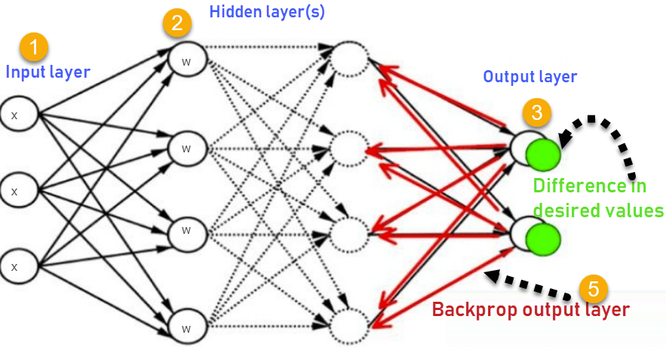
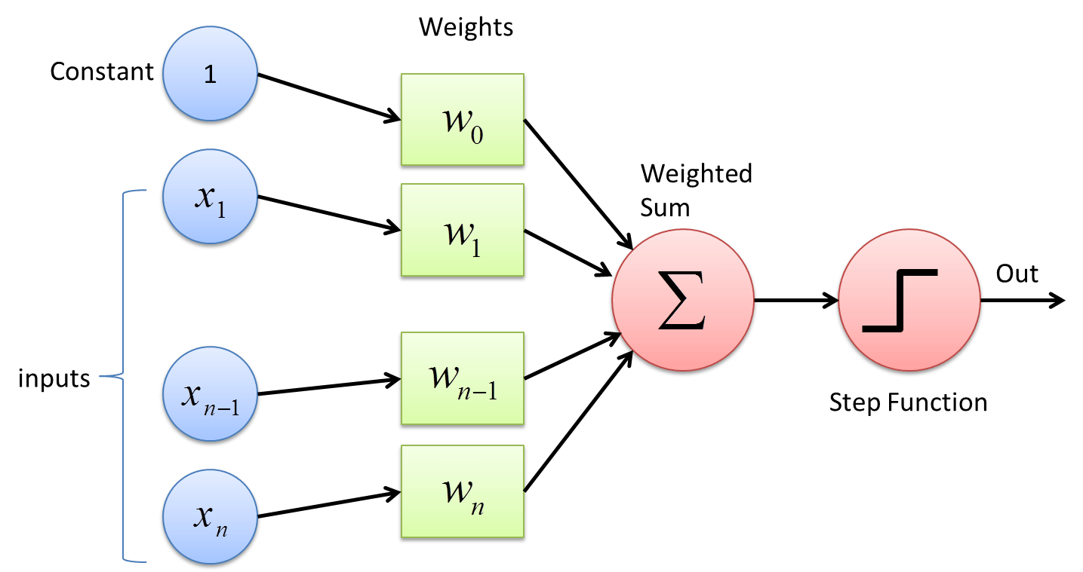
Inputs X, arrive through the preconnected path
Input is modeled using real weights W. The weights are usually randomly selected.
Calculate the output for every neuron from the input layer, to the hidden layers, to the output layer.
Calculate the error in the outputs
Error(B) = Actual Output – Desired Output
Travel back from the output layer to the hidden layer to adjust the weights such that the error is decreased.

Slide 16

Results and Discussion
The various machine learning algorithms applied in the project gave different kinds of results with various accuracy scores.
These algorithms have been compared based on their mean squared error(MSE), mean average error(MAE) and R2 score.
The Mean Squared Error measures how close a regression line is to a set of data points. It is a risk function corresponding to the expected value of the squared error loss.
Mean Absolute Error calculates the average difference between the calculated values and actual values
MAE = (1/n) * ∑|yi – xi|
It is the amount of the variation in the output dependent attribute which is predictable from the input independent variable(s)
R2= 1- SSres / SStot

Slide 17
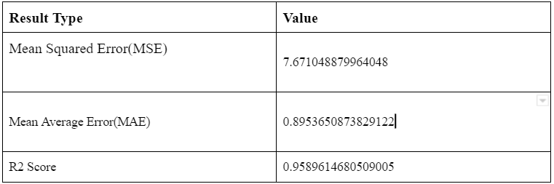
Results of Random Forest Algorithm
The following are the results for the Random Forest Algorithm:

Slide 18
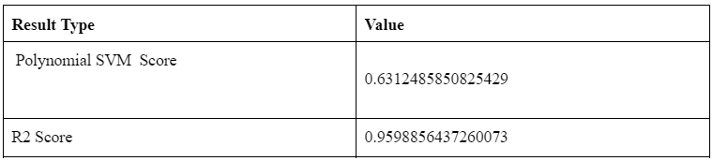
Results of Support Vector Machine
The following are the results for the Polynomial Support Vector Machine(SVM) Algorithm:

Slide 19
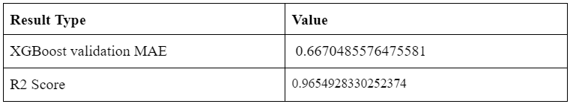
Results of XGBooster Algorithm
The following are the results for the XGBooster Algorithm:

Slide 20
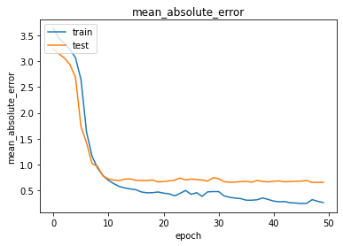

Results of Neural Network algorithms
The following are the results of the Neural Network Algorithm:
Mean Absolute Error
Model loss

Slide 21
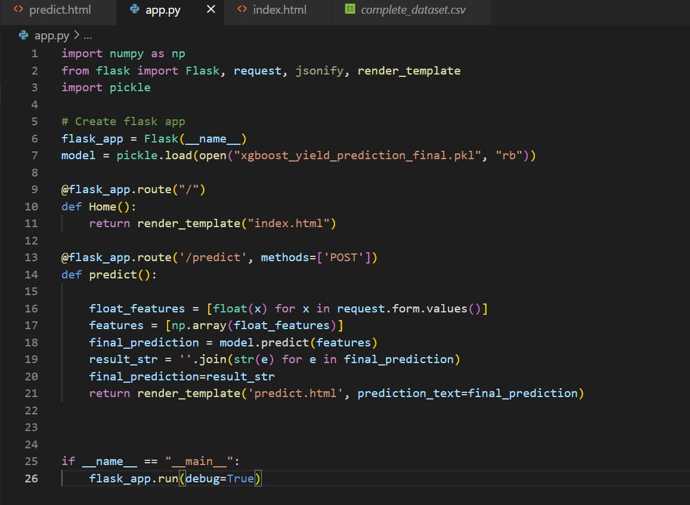
Code for website

Slide 22
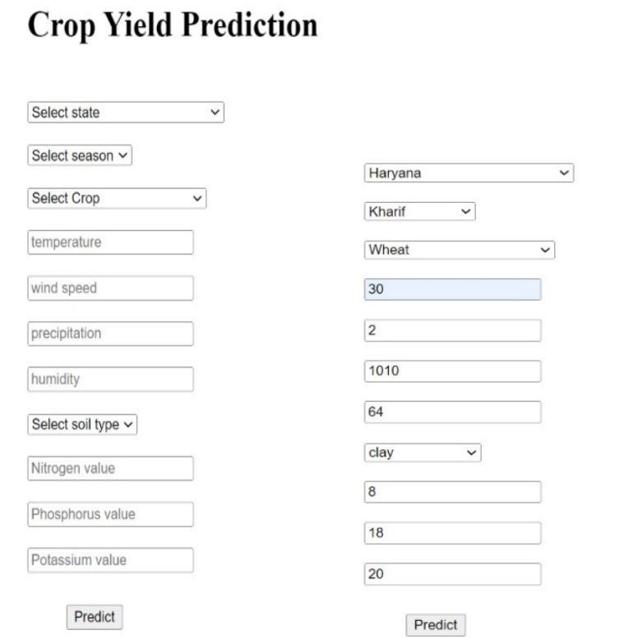
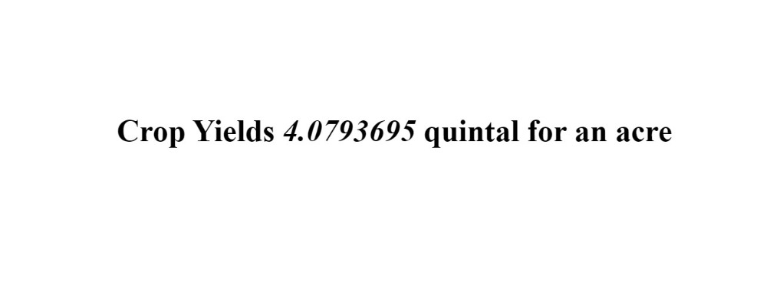

Output:-

Slide 23
Discussion of Results
From the given values of errors,we can understand that Extreme Gradient Booster(XGBooster) is the algorithm which gives the highest R2 Score.This is because in XGBooster, after the model is trained for a part of the dataset,then the model is tested. After the testing is done,the weights of the misclassified points are increased so the probability of selecting them is increased.In this way,we ensure that the misclassified points get trained more so that the machine learning algorithm can classify those points correctly in future.
Because of this regular updation of weights and repeated training, XGBooster algorithm gives the highest accuracy while predicting.

Slide 24
Conclusion and Future Scope
Our system helps farmers predict the yield of a given crop and also helps them to decide which crop to grow. The system also provides a list of crops with their productions based on climatic conditions.
One of the most important and novel contributions of the system is to suggest to the user the right time to apply fertilizer, by forecasting the weather for the next 14 days.
The Future Work focuses on a fully automated system that will provide a sequence of crops to grow depending on soil and weather conditions and update the datasets from time to time to make accurate predictions.
In the future, this model can be implemented across India by adding data points for all regions. Our system can be integrated with a messaging module so that registered farmers can receive forecast notifications directly to their registered mobile numbers.

Slide 25
References
Anakha Venugopal, Aparna S, Jinsu Mani, Rima Mathew, Vinu Williams Crop Yield Prediction using Machine Learning Algorithms, 2021
Dhivya Elavarasan, P. M. Durairaj Vincent “Crop Yield Prediction Using Deep Reinforcement Learning Model for Sustainable Agrarian Applications”, IEEE Access, 2020.
Thomas van Klompenburg, Ayalew Kassahun,Cagatay Catal “Crop yield prediction using machine learning: A systematic literature review” Computers and Electronics in Agriculture, Volume 177, October 2020.
Sangeeta, Shruthi G, “Design And Implementation Of Crop Yield Prediction Model In Agriculture”,2020.
YongKang Xing, JiaPeng Huang, YongYao Lai “Research and Analysis of the Front-end Frameworks and Libraries in E-Business Development”, Proceedings of the 2019 11th International Conference on Computer and Automation Engineering - ICCAE 2019, 2019.
Ranjini B Guruprasad, Kumar Saurav, Sukanya Randhawa,”Machine Learning Methodologies for Paddy Yield Estimation in India: A CASE STUDY”, 2019.
P.Priya, U.Muthaiah & M.Balamurugan Predicting Yield of the Crop Using Machine Learning Algorithm, International Journal of Engineering Sciences & Research Technology (IJESRT), April, 2018.
S. Pavani, Augusta Sophy Beulet P “Heuristic Prediction of Crop Yield using Machine Learning Technique”, International Journal of Engineering and Advanced Technology (IJEAT) Volume-9, December 2019.
Sriram Rakshith.K,Dr. Deepak.G, Rajesh M, Sudarshan K S, Vasanth S & Harish Kumar, “A Survey on Crop Prediction using Machine Learning Approach” International Journal for Research in Applied Science & Engineering Technology (IJRASET) Volume 7, Issue IV, Apr 2019

